Slide 1
Photo Printing Overview
Steven Fischkoff
Livingston Camera Club
July 29, 2019

Slide 2
Should I Print Myself or Send It Out?
How often do I plan to print?
Do I want full control over the print?
Do I want to learn the craft of printing or just get the final product?
Do I want the ability to reprint if I’m not totally satisfied with the result? Am I willing to wait to see the print?
Printing ain’t cheap, either oneself or outside. Have I figured out the economics?
Printer, paper, ink (keep inventory), mounting supplies
Do I want the ability to print on specific papers?

Slide 3
Getting the Print to Match the Screen
Both the color and tonality of the print should be just what you expect from looking at the monitor
Color managed workflow – whether you print yourself or not
Calibrate your monitor
Soft proof your final print
Use appropriate color space
Use appropriate printer profile if you print yourself
Lower brightness of monitor and lighten image prior to printing since monitor brighter than paper

Slide 4
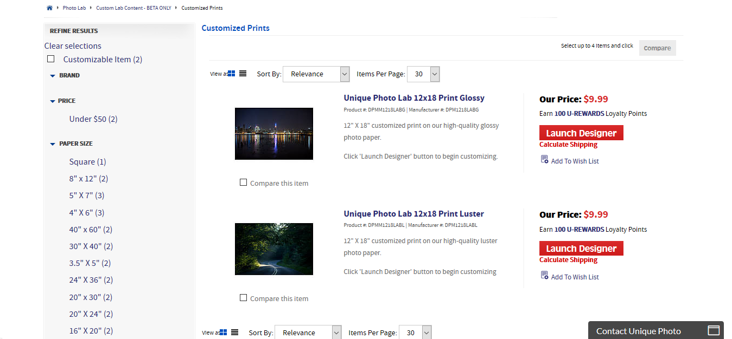
Unique Photo Product Selection

Slide 5
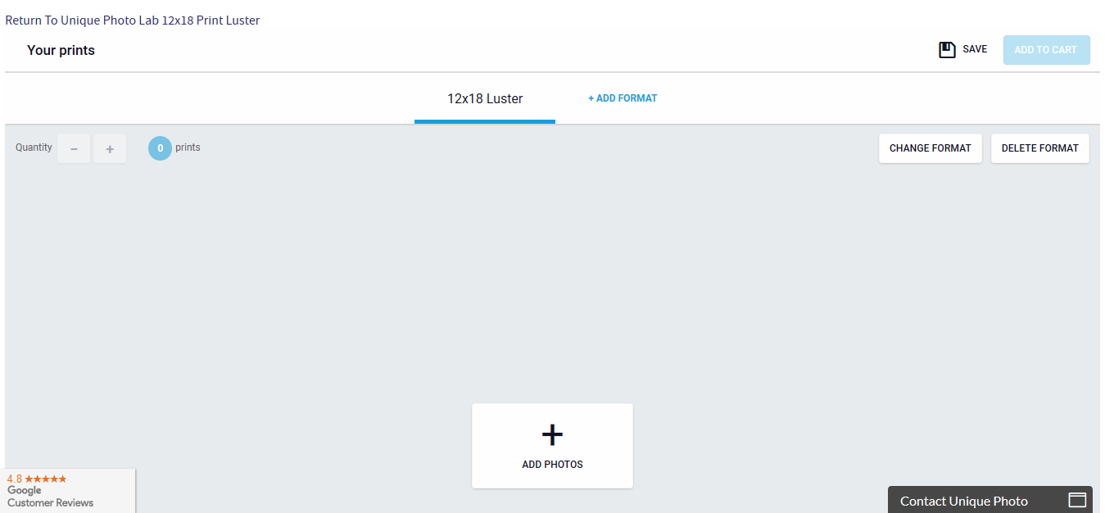
Unique Photo Upload Page

Slide 6
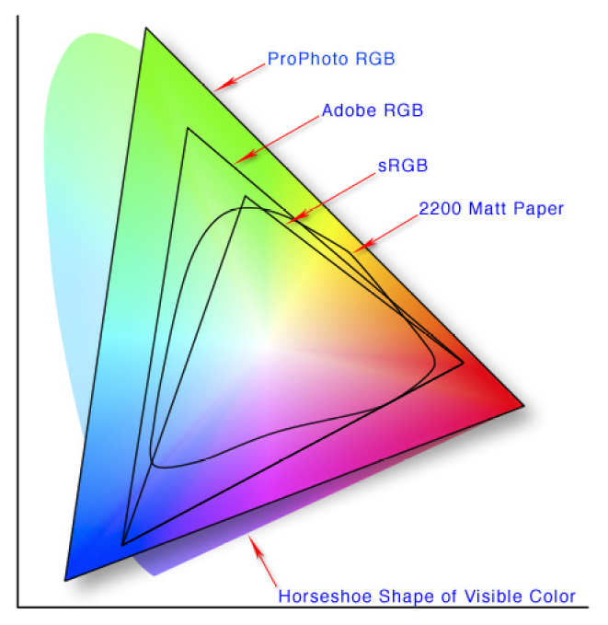
Color Spaces

Slide 7
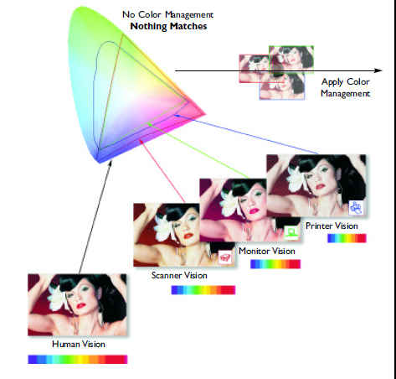
Monitor / Printer Mismatch

Slide 8
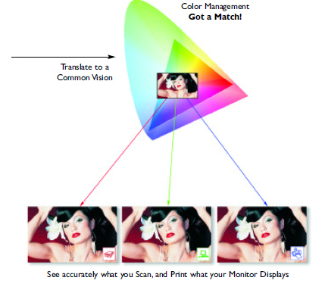
Monitor Matches Printer

Slide 9
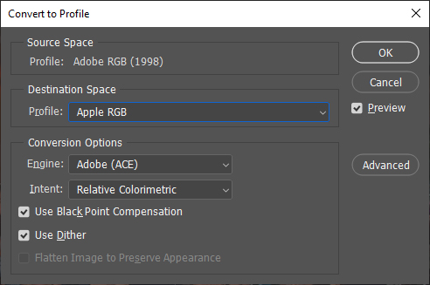
Convert to Profile Dialog

Slide 10
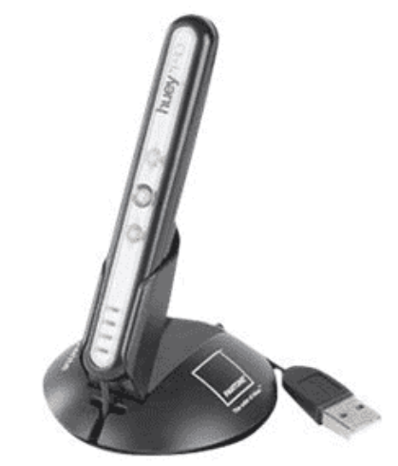
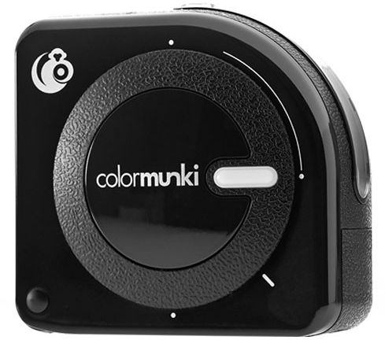
Monitor Calibration Demonstration

Slide 11
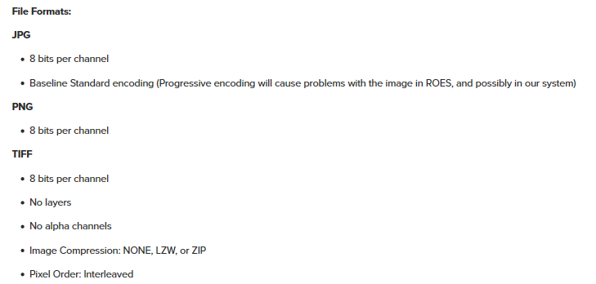
Bay Photo Acceptable Formats

Slide 12
Bay Photo Color Correction Policy

Slide 13
Bay Photo Photoshop Setting Recommendations

Slide 14
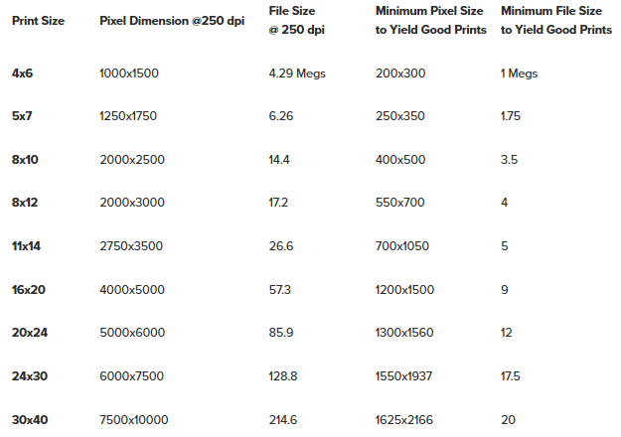
Pixel Dimensions to Give Good Prints

Slide 15
Selecting a Printer
Purpose (general, photo specific)
Brand
Maximum width
Printer size
Stand vs desk
Pigment vs dye
Cost to operate
Rolls for panoramas?, CD carrier?
How to connect (USB, wired & wireless network)

Slide 16
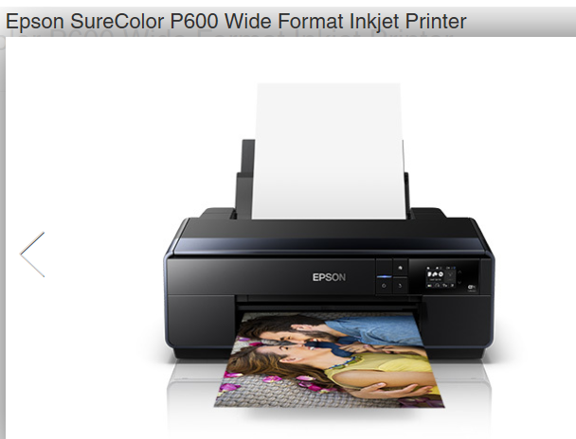
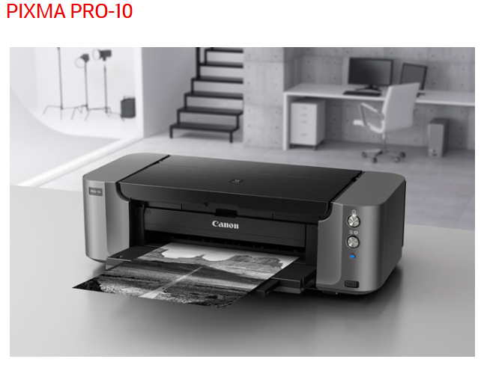
Modern Photo Printers

Slide 17
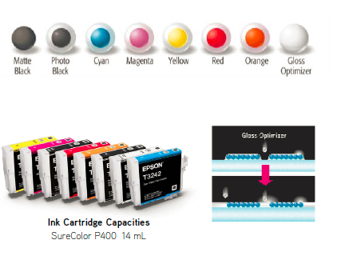
Epson Inks (Pigment)

Slide 18
Buying Paper
Size
Surface
Gloss
Luster
Matte
Fine Art
Special – canvas, linen, etc.
Tone
One sided vs Two sided (for photo books)
Sheets vs rolls (for panoramas)

Slide 19
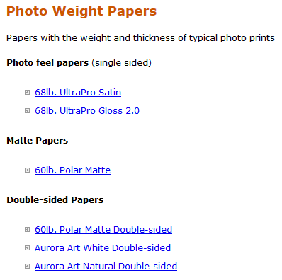
Red River Papers for Photographers
Many quality vendors
RR papers tend to be high quality at fair price
Order by size, quantity and surface
Thickness of paper expressed as weight
Can also order fine art papers, card stock, rolls
Most paper vendors offer sampler packs

Slide 20
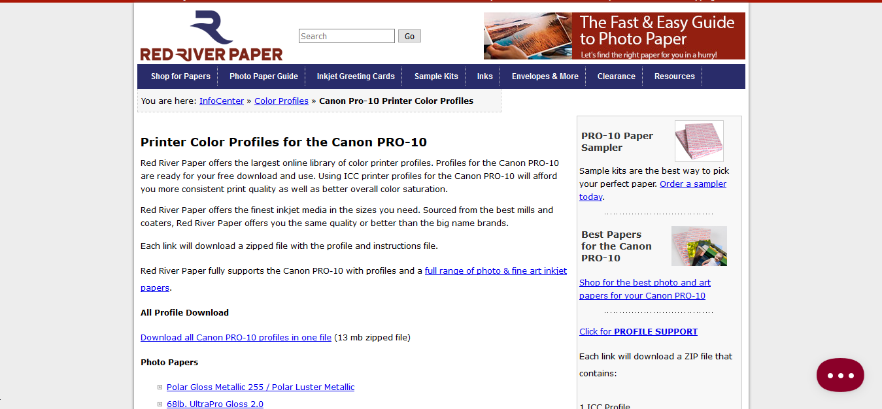
Red River Paper ICC Profile Download

Slide 21
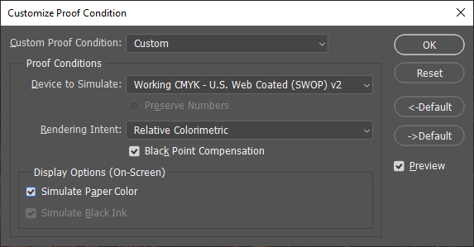
Soft Proofing
See on your monitor what print will look like (approximately)

Slide 22
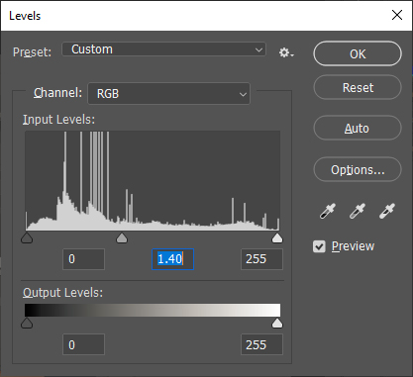
Levels Dialog with Gamma 1.40

Slide 23
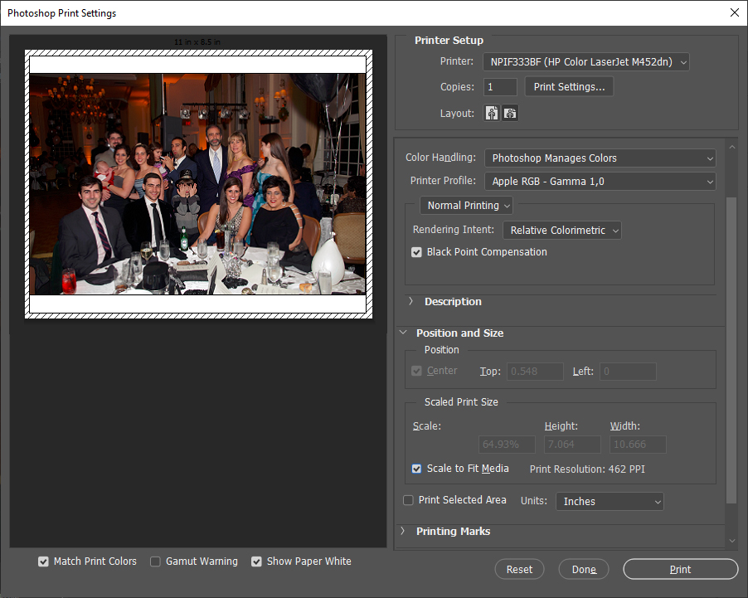
Print Dialog

Slide 24
Mounting for Competition
Reusable Mount – see LCC web site
Foam Board
Where to buy (beware of shipping costs)
How to mount
How to trim

Slide 25
Go Forth and Print!
Good night

